Slide 1




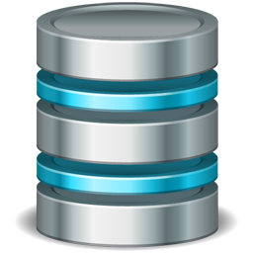


Automating Salesforce Data Migrations with Python
Simple steps to extract, transform and load data into Salesforce
Salesforce
Kimberly Small
RadixBay Salesforce Consultant
www.radixbay.com
Notes:
I’d like to thank you for viewing my presentation on Automating Salesforce Data Migrations with Python. If you would like to download a copy of the slides from this presentation, please visit our website at www.radixbay.com. There is a “Resources” link in the upper right corner.
In addition to my presentation, I’ll also be providing a brief data migration demo.

Slide 2


Who We Are
RadixBay
RadixBay is an IT consulting and managed services provider with headquarters in Charlotte, NC and a rural shore delivery center in Tabor City, NC.
RadixBay offers a broad range of enterprise-grade IT services that include Salesforce support, application development and testing, packaged application management, strategic advisory services and 24x7 data infrastructure support. Our end-to-end solutions help you to quickly leverage new business opportunities, improve operations and reduce risk.
Our Model
RadixBay’s easily customizable, budget-friendly solutions allow clients to tailor development projects and support packages that meet their unique needs.
The RadixBay model utilizes rural delivery centers to provide 100% onshore development and support services. Rural shore combines the cost benefits of offshore services with the security and simplicity of onshore support to deliver cost effective, high-quality solutions.
RadixBay’s global customers are in all major market verticals and range from startups to Fortune 500 organizations.
Notes:
Here’s a brief intro to the services my company provides. On the right part of this slide you can see that we offer a wide range of support solutions.

Slide 3

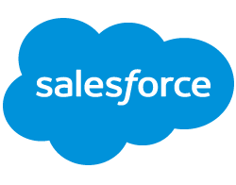
End-to-End Salesforce Services
Strategic Planning
Roadmap Development
Needs Analysis and Design
Implementation
Configuration
Customization and Development
Training
Systems Integration
Optimization
Upgrades
Ongoing Support
Health Checks
Notes:
I’m a member of RadixBay’s Salesforce consulting team.
My team is able to tailor your Salesforce products to your business needs, easily integrate your platform with other systems and fully leverage all of Salesforce’s advanced features.
And – help you migrate your data from legacy systems into Salesforce.

Slide 4






Agenda
Introduction
Migration Process
Demo
Tools & Libraries
Best Practices
Resources
Notes:
Here’s today’s agenda. We’ll begin with a traditional introduction, discuss the migration process and I’ll provide a demo.
After the demo we’ll take a look at the tools and libraries that we can use to automate our migrations and I’ll provide my Top 5 recommendations.
At the end, I’ll provide you with a list of resources that will help you build your own automations.
I’ll make sure to upload a copy of my slides to our website at www.radixbay.com. That way you can download a copy and access all of the websites I provide on my resources slide.

Slide 5
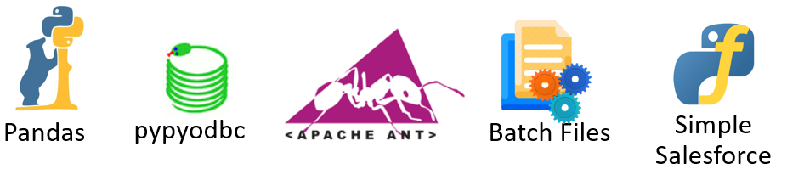
Introduction to Python Data Migrations
Salesforce
Notes:
Here’s a subset of some of the products and tools we’ll be discussing during the presentation.
The list of products may look a bit challenging at first but by the end of the presentation, I think you’ll find that, with a bit of time, you’ll be able to use them to automate your own data migrations.

Slide 6

What is a Data Migration?
Move data from one system to another
MUST be completed before go-live
Can be a stressful, time-consuming task
Data transformations are often required to clean or modify the data to meet the target system’s requirements.
Notes:
Legacy → New System
Occurs during Salesforce Implementations
Data MUST be migrated before Go-Live
Stressful and Time Consuming if….
Performed manually
You lack a well thought out migration plan
You don’t understand the client data

Slide 7
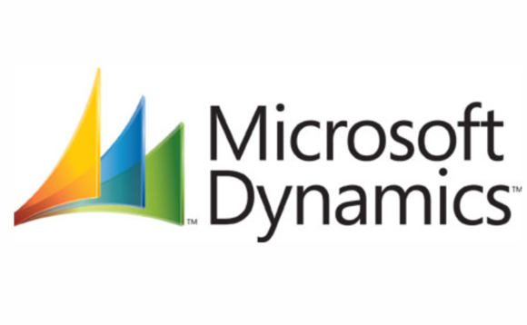
Conversions
Notes:
2 Migrations
Microsoft Dynamics → Salesforce
Involved a lot of data transformations and data cleanup
Salesforce → Salesforce
Easier to complete, but still ran into some unexpected issues

Slide 8
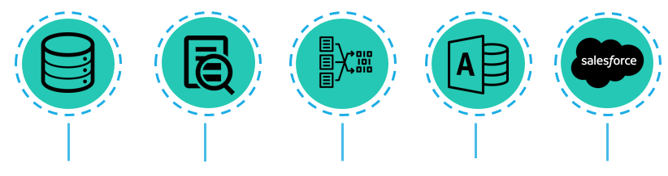
The Data Migration Process
Extract Data
Transform Data
Load to Access
Load to Salesforce
Analyze Data
Notes:
The data migrations I completed involved several steps. This is just a general overview of each step I took. I will go into more detail about some of these steps later in the presentation.
Client extracts data from legacy systems (CSVs)
Took the data and thoroughly analyze it
This in
Used analysis to transform and clean the data
Loaded the data into MS Access
All prepped data stored in one location
Made it easier to quickly view data
Loaded the data from MS Access into Salesforce
I used python to automate the data migrations
Automate this process as much as possible!
Avoid manual work
You would have to complete those manual steps each time you run a test migration and if you need to run data updates after go-live
Save time during the migration process

Slide 9
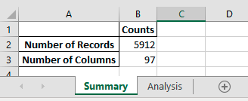
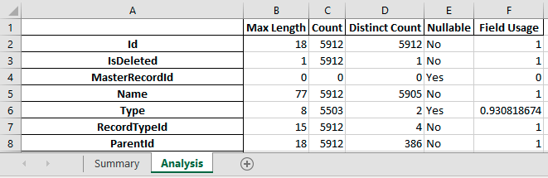
Data Analysis
Manually observe data
  TIP: Python can split large CSVs into smaller
  files
Automate the collection of the following:
  # of records
  # of columns
  Max length of values in each column
  Count of values in each column
  Distinct count of values in
  each column
  Nullable Fields
  Field Usage
Notes:
Take your time and thoroughly observe the data
Look for data inconsistencies, dirty data, and things like that
If a CSV file is too large to view in Excel, you can use Python to split that CSV into smaller files
EXMAPLE:
CSV with 3M Records → Just get a subset of that data to observe
Automate quantitative analysis
This is an example of the file that’s generated when I run my data analysis tool
I will demo that later

Slide 10
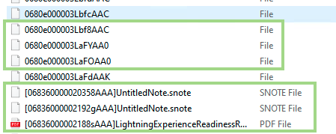
Data Transformation
Use analysis and client requirements to transform data
Possible Transformations:
  Update Record Types
  Update Files
  Clean Email Addresses
  Fix Dates
Format after client exports Content
Format after File Update
 | Email
0 | <j.doe@test.com>
1 | mailto:t.smith@test.com
2 | p.wong@test_com
 | Email
0 | j.doe@test.com
1 | t.smith@test.com
2 | p.wong@test.com
Notes:
Use your analysis and client requirements to transform client data.
ALL data transformations should be automated.
You don’t want to forget to perform a transformation because you choose to do it manually.
I have listed a few of the transformations I had to complete
There are also some examples
Cleaning email addresses
Updating file names

Slide 11
Order of Migration
Users
Accounts
Contacts
Opportunities
Leads
Events
Tasks
Email
Notes
Attachments
Content
Notes:
You should determine the order of migration before building out any migration code.
The order of migration is extremely important.
You can’t load in any records if you haven’t loaded in the users. Those records would belong to you instead of the correct record owner.
You wouldn’t be able to load a set of contacts if their related account isn’t already in Salesforce.
This displays the order of your main objects in Salesforce. You will need to update this order with teams, relations, and custom objects if needed.

Slide 12
Demo

Slide 13

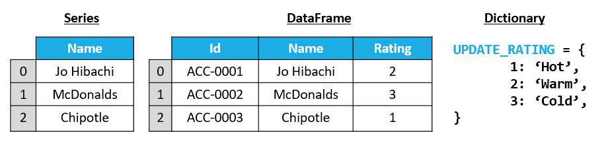
Pandas
Automate Data Analysis and Transformations
  DataFrame: Table
  Series: Column in Table
  Dictionary: Maps data values in key:value pairs
Notes:
Let’s continue our discussion by taking a look at the tools and libraries I use for my data migrations.
Well begin by reviewing Panda
Python library that can be used for data analysis and transformations
3 main data structures
Dictionaries are pandas specific, but are used to update values, rename columns, and things like that
Also will use lists and tuples (which are like lists)

Slide 14
Pandas Functions/Attributes For Data Migrations
read_csv() - Pulls data from CSV File into a dataframe
Shape - Quickly retrieve the number of rows and columns in a dataframe
count() - Returns the number of values in a column
nunique() - Returns the unique number of values in a column
replace() - Replaces values in a dataframe or series using a Dictionary
merge() - Perform vlookup / join operations
apply() - Apply custom functions to a dataframe
rename() - Rename columns in dataframe
drop() - Drop columns in dataframe
dropna() - Drop rows in a dataframe based on blank values in a column
filna() - Fill blank values in a dataframe or series with a given value
concat() - Combine multiple dataframes
Notes:
Here are some of the functions and attributes I used the most during the data migrations
I won’t cover all of these

Slide 15

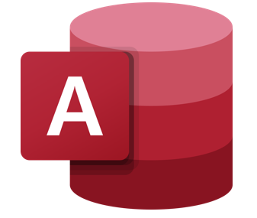
PYPYODBC
Connect to MS Access DB
Query, insert, and delete MS Access data
Can be slow at times
  Example: 30 minutes to load ~ 60,000 contact records into MS Access
Notes:
Used to load transformed data into MS Access
There is another library that can load the data into MS Access, but I received errors with that package. (pyodbc)

Slide 16
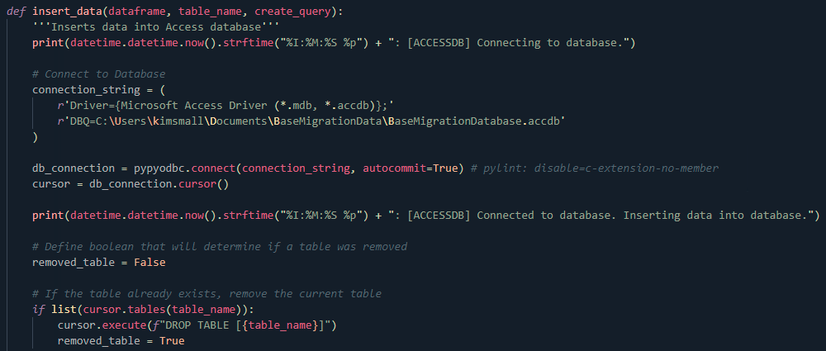
PYPYODBC
Notes:
This snippet of code shows how to connect to an Access database and manipulate it using PYPYODBC. You can see that text is printed to the console to provide update as the data is loaded into the Access database.
I placed this database function in a utilities file so that it could reused throughout the migration code.

Slide 17
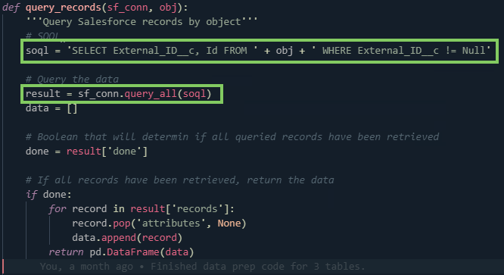
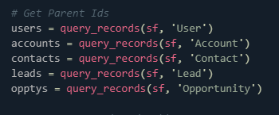
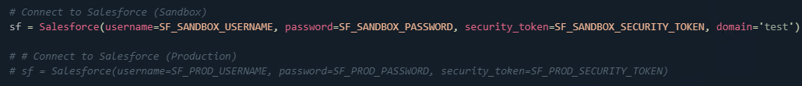
Simple Salesforce
Connect to any Salesforce org
Query records using SOQL
SOQL ~ SQL
Notes:
Allows you to connect to any Salesforce org
Username
Password
Security Token
Specify domain if you need to connect to a Sandbox
SOQL
Salesforce Object Query Language
Similar to SQL
I created a function that allows me to use the same SOQL statement to retrieve the External ID and the Salesforce ID of any records for any object.
External ID is the ID from the Legacy System and is used to relate records
This function was also placed in the utilities file. Writing resuable code is extremely important and will save you a lot of time when coding data migrations.

Slide 18

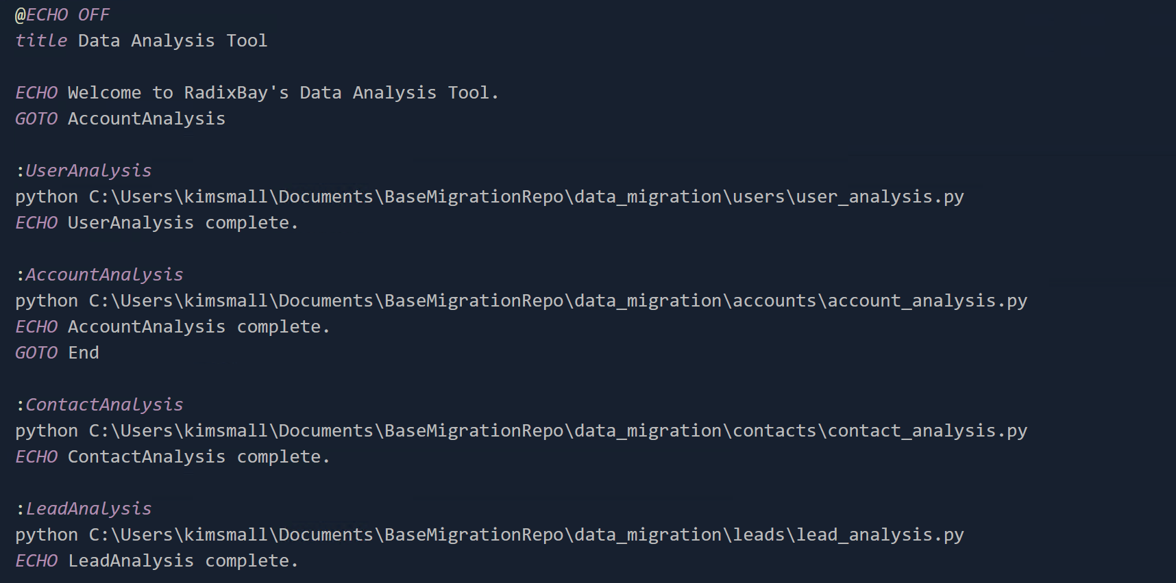
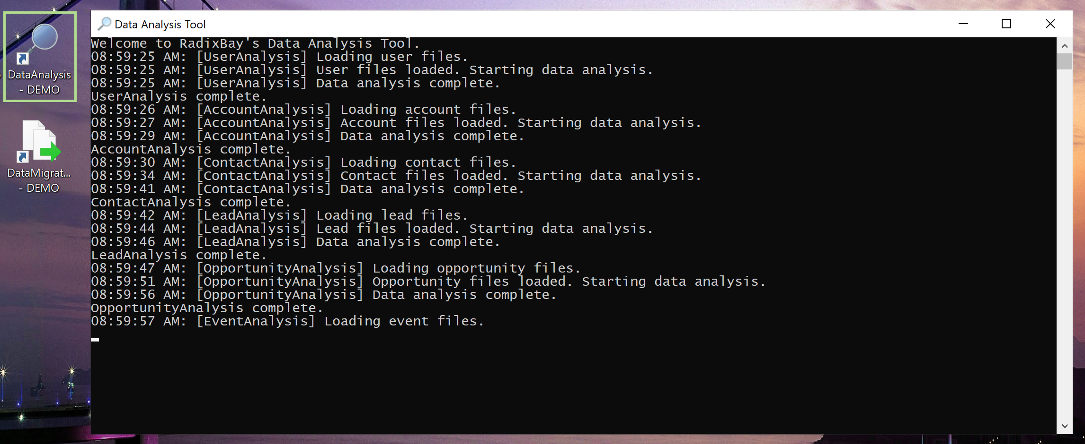
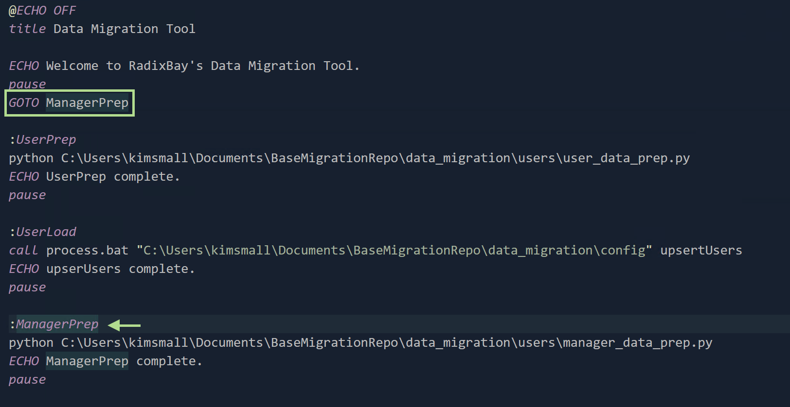
Batch Files
Automate Python scripts and Data Loader jobs
List scripts and jobs in the correct load order
Notes:
Rearrange the screenshots to show the command lines you want to talk about
Automate Python Scripts and any Data Loader jobs
You can use GOTO commands and Labels to skip ahead in the migration
Example: Let’s say you loaded in records for a few objects on Thursday and you want to load the rest Today. Use the GOTO Command to point to the correct label in the Batch file
Minimize the amount of GOTOs you use in your batch code to avoid spaghetti code.

Slide 19
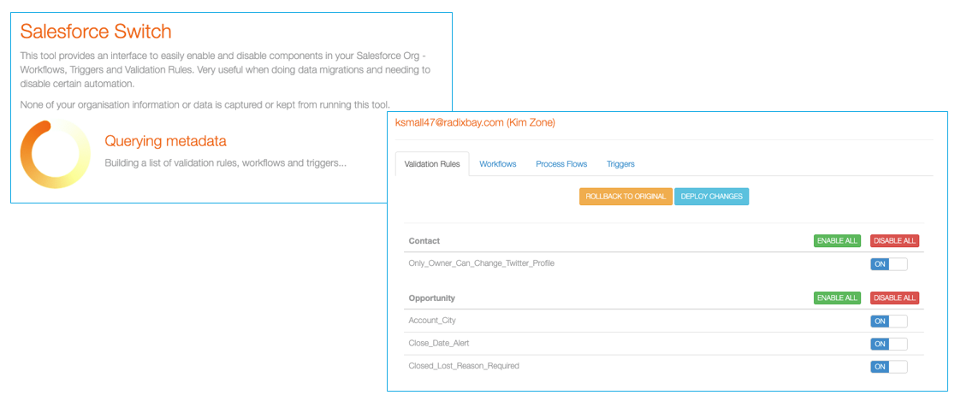
Salesforce Switch
Quickly enable/disable Salesforce configurations
Notes:
Disable:
Workflows
Process Flows
Triggers
Validation Rules
It’s important to turn off some of these configurations because they can update data and restrict records from being loaded in.

Slide 20
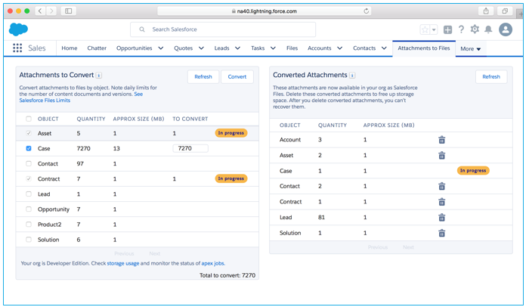
Attachments and Notes Migrator
Converts Attachments and Notes into formats that are optimized for Lightning
  Attachments → Salesforce Files
  Notes → Enhanced Notes
Download from
AppExchange
Notes:
AppExchange App by Salesforce
Clients may have the older attachments and notes. Those need to be upgraded so that they are optimized for Salesforce Lightning.
Background: Salesforce has two interfaces: Classic and Lightning. Lightning is the new and improved interface. And Salesforce is pushing to retire Classic. Therefore it is important to update these formats.

Slide 21


Data Migration Permission Set
System Permissions
  Set Audit Fields upon Record Creation
  Update Records with Inactive Owners
  Bulk API Hard Delete
App Permissions
  View and Edit Converted Leads
  Query All Files
Notes:
Not really a tool, but it is needed for Salesforce migration.
Please ensure that you have these permissions enabled for your user, or you will not be able to load in records or update them as expected.
Set Audit Fields upon Record Creation
Created By
Last Modified
Update Records with Inactive Owners
Normally, you can’t insert records if the record owner is inactive
NEEDED FOR UPDATES / DELETIONS
You may have loaded something in wrong. Now you need to either update the record or delete it.
Bulk API Hard Delete
View and Edit Converted Leads
Query All Files
Denise – I think this is the permission you need to enable to delete those private content files whenever we do a data purge for a client

Slide 22
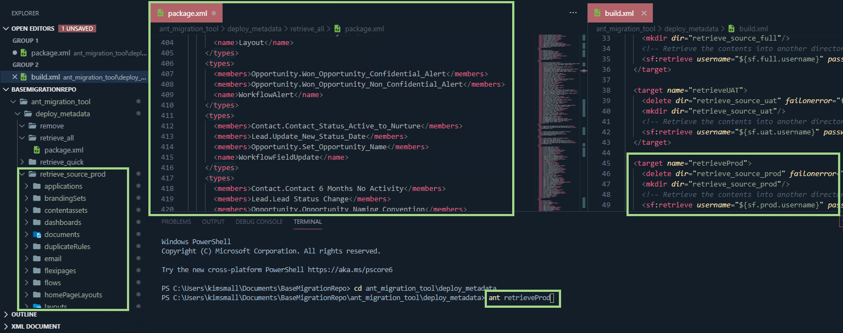
ANT Migration Tool
Push metadata to Salesforce orgs
Behaves like a Change Set
Define Metadata to retrieve in package.xml file
1
Create target orgs in the build.xml file
2
Metadata is retrieved and can be deployed
3
Call the ANT target in your terminal
4
Notes:
Can’t migrate data if you don’t have the correct fields, picklist values, team roles, etc.
You’ll need to push config changes from the Config Sandbox to both the Stage Sandbox and the Production Sandbox
Normally use change sets to deploy our configurations.
Allows you to retrieve and deploy Salesforce configurations.
You can move configurations to/from any Salesforce org. They don’t have to be related orgs.
I think I’ll do a lunch and learn on this tool later, but just wanted to give an overview.

Slide 23
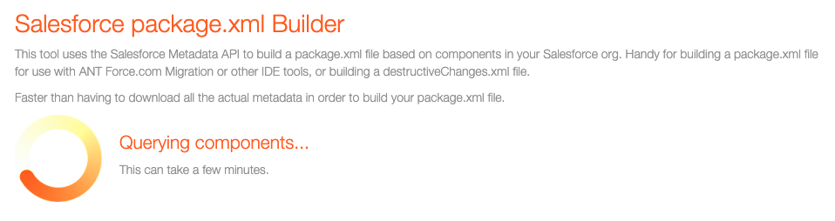
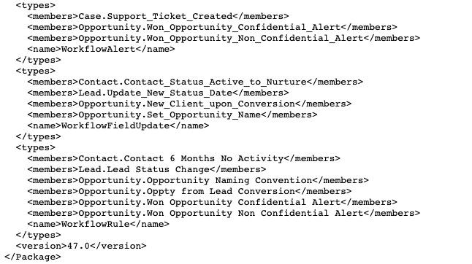
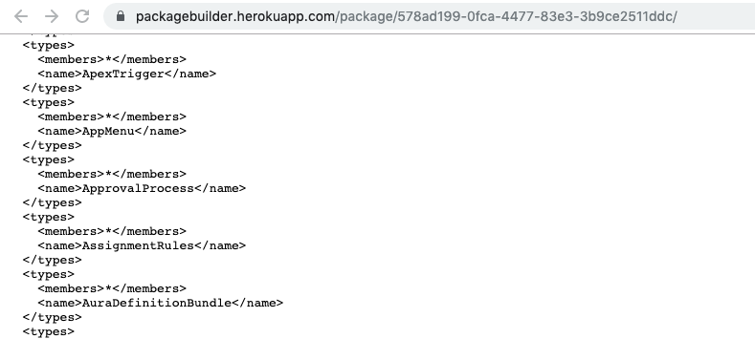
Salesforce package.xml Builder
Quickly retrieves Salesforce metadata in XML format
Notes:
Allows you to retrieve Salesforce metadata in an XML format
To be used with the ANT Migration Tool
Once again, I’m not going to cover this as much, just wanted to introduce the tool to you.

Slide 24
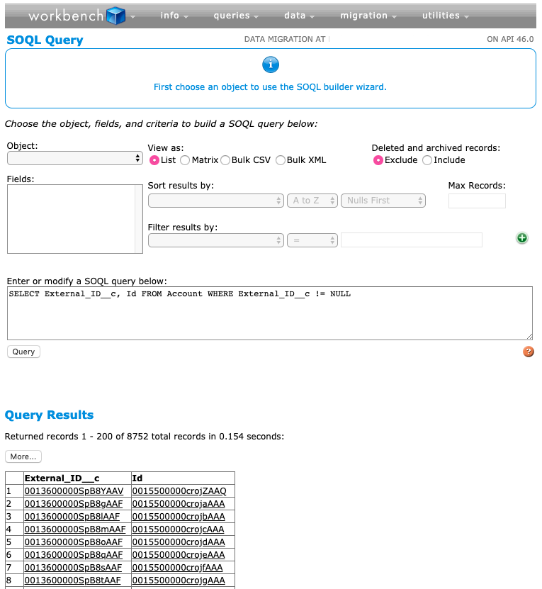
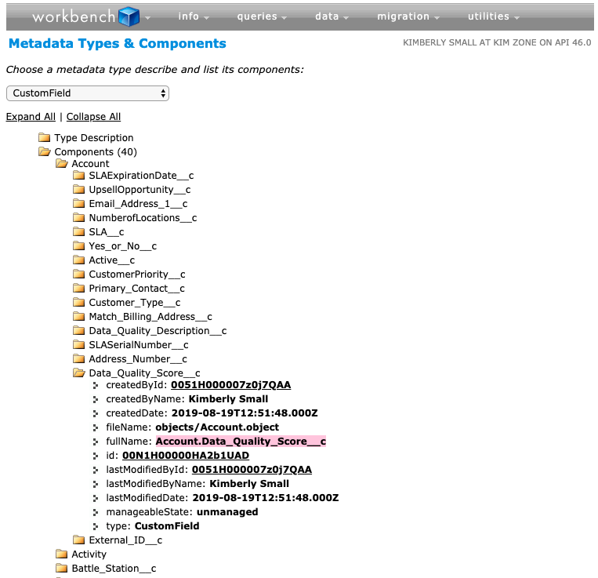
Workbench
Connect to any Salesforce org
Run SOQL queries
View metadata
Quickly perform DML operations
Notes:
Final Tool
Great to have all of these features in one location

Slide 25

Top 5 Recommendations
Complete a data migration workbook
Migrate using legacy IDs
Check configuration
Be aware of system limits
Test your configuration
Notes:
Let’s finish up by reviewing my top 5 recommendations. I'll dig a little deeper into each one of them in upcoming slides.

Slide 26
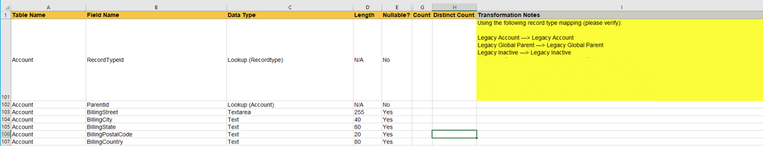
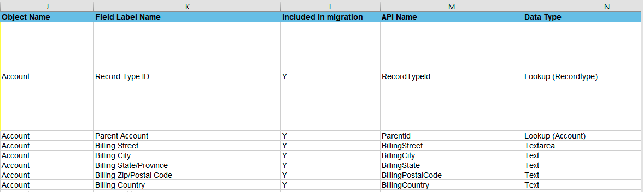
Complete a Data Migration Workbook
Why
Data mapping for each object in one location
Take note of data transformations
Notes:
Data Mapping: the process of choosing a destination for legacy data in a new system
Keep this Workbook as updated as possible
Be sure to update if field names / api names change in the new system
If you use this workbook to build out your migration code, which you should, you will have incorrect api names in your code

Slide 27
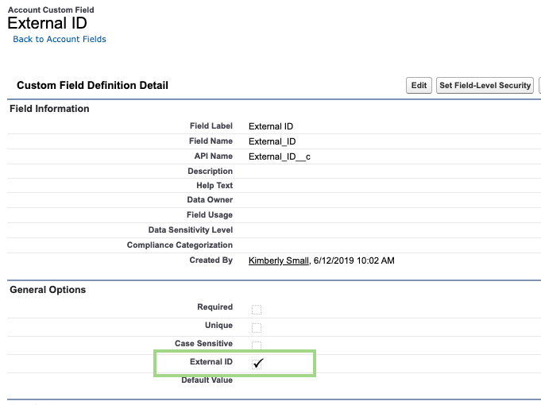
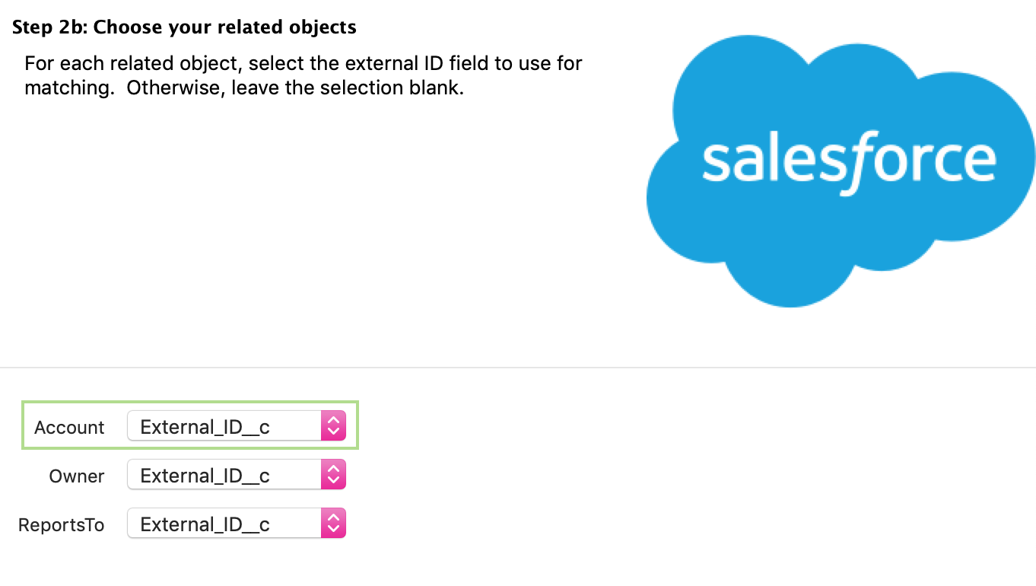
Migrate Using Legacy IDs
Why
Relate records using Legacy IDs
  Avoid constant exports and vlookups
  Exception for polymorphic fields like WhoId and WhatId
Helps with troubleshooting and data updates
How
Map the Legacy ID to an External ID field in Salesforce
Notes:
Polymorphic relationships occur when the referenced object can be related to several different types of objects.
Tasks can be related to more than one type of object
You’ll want to create an External ID field in Salesforce on each object that will be included in the migration
There are a few objects you won’t be able to add an External ID to, like Attachments and Relations

Slide 28
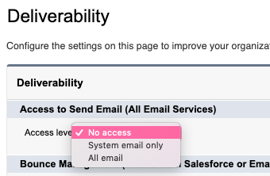
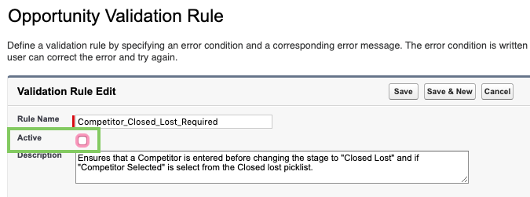

Check Configuration
Why
Configurations may cause errors
  Restricted Picklists
  Validation Rules
  Apex Triggers
  Flows
How
Deactivate configurations
Un-restrict picklists
Turn off Emails
NOTE: Reset configurations after
the data migration

Slide 29
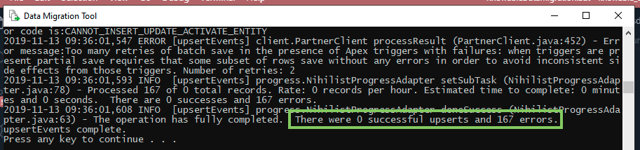
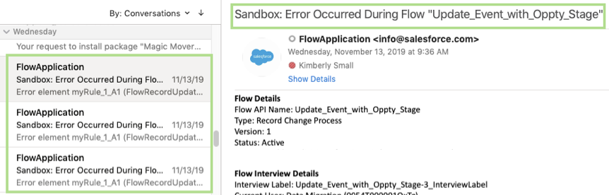
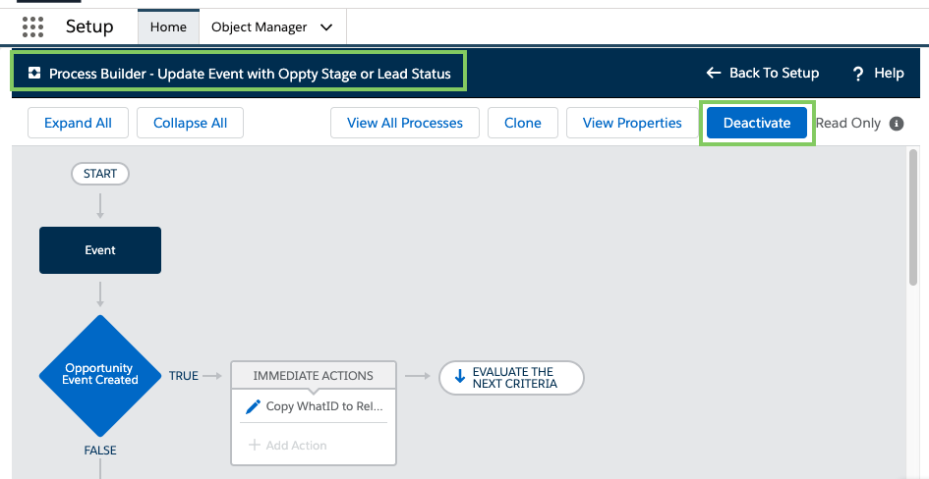
Error – Example 1
Notes:
Example 1
Loading event records and ran into errors
Also received Flow Emails from Salesforce
Realized a Process Flow was causing the error
Deactivated the Process Flow

Slide 30
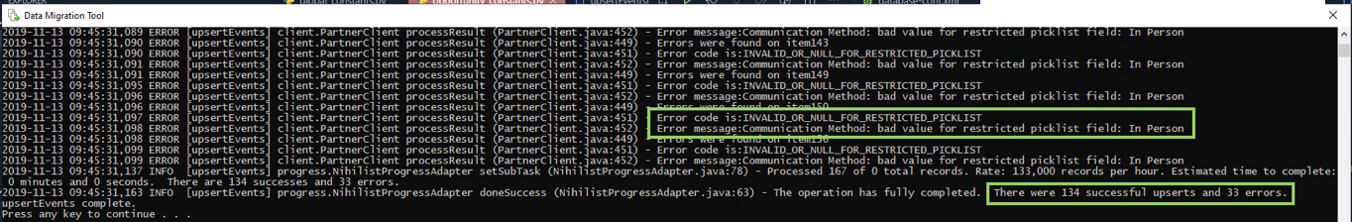
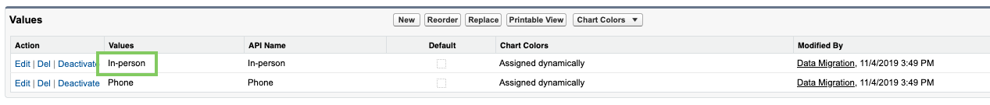
Error – Example 2
Notes:
Example 2
Tried loading event records again and still ran into errors
Error stated that I was loading in an invalid picklist value for the Communication Method field
Checked the Picklist values in Salesforce and realized the name of the picklist value was wrong

Slide 31
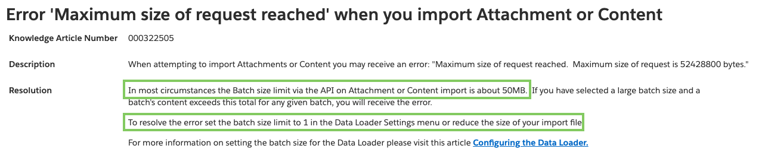
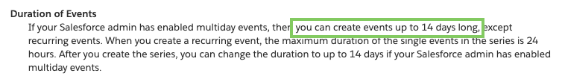
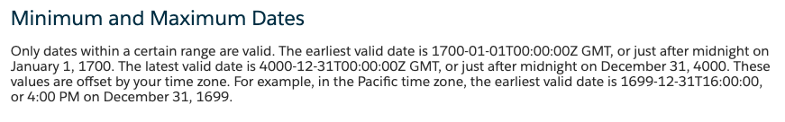
Be Aware of System Limits
Why
Several limitations can cause errors during the migration, which extends the duration migration ☹
How
Transform client data to avoid the limitations
Notes:
If I hit a Salesforce limit, I likely had to update my code and rerun both the data transformations and loading process. For large amounts of records, this can take a while to rerun.
This can apply to any system you migrate data to. You need to learn what the system can and can’t do to avoid unpleasant surprises during the migration.

Slide 32

Test Your Migration
Why
Identify bugs and potential errors
Identify missing data
How
Use a Full Sandbox
Allow client to QC data
Update scripts as needed
Notes:
It’s easy to set things up wrong
You may run into errors you weren’t expecting
You don’t want to wait until a few days before Go-Live to experience issues you’ve never encounter before
Testing exposes many issues at an early stage
Allows you to enhance your migration tool

Slide 33
Resources
Please visit www.radixbay.com/resources/ to download the slides.
Salesforce Migration Tools
Workbench
Ant Migration Tool
Salesforce package.xml Builder
Data Loader Command Line
Salesforce Switch
Attachments & Notes Migrator
Python Libraries
Pandas
Simple Salesforce
Pypyodbc
Helpful Articles
Data Preparation with Pandas
Choosing the Right ETL Tool or Middleware for Your Salesforce Data Migration or Integration
Metadata API Developer Guide
Automation with batch files and scheduled tasks
Helpful Videos
Salesforce and Python Integration Playlist
Deploying Metadata with the Force.com Migration Tool
Helpful Cheat Sheets
Python Regex
Data Wrangling with Pandas
Notes:
I provided some helpful resources for Data Migrations. Please visit www.radixbay.com/resources to download a copy of the presentation. This will allow you to access all of the websites I refer to in this slide.
Thanks!

Slide 34
Thanks from the RadixBay Salesforce Team!
For more information, please visit www.radixbay.com
Notes:
I would like to thank you for viewing my presentation on using Python to perform Salesforce data migrations.
If you would like more information on any of our services, please visit www.radixbay.com

Slide 35
Thanks from the RadixBay Salesforce Team!
For more information, please visit www.radixbay.com
Notes:
I would like to thank you for viewing my presentation on using Python to perform Salesforce data migrations.
If you would like more information on any of our services, please visit www.radixbay.com

